Slide 1
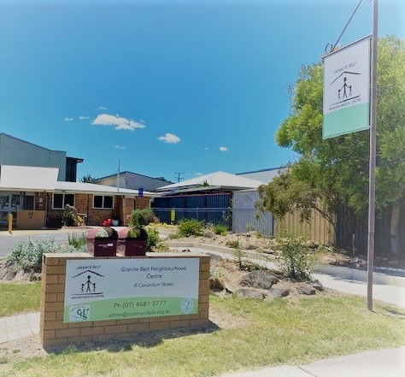
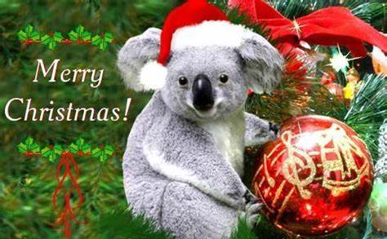
GBNC Newsletter
What’s happening at GBNC
Summer 2023
What’s on weekly at GBNC
Mondays
Kids Korner Childcare
GBNC Client appointments
Brick Club - Thulimbah school – term-time only
Emergency Relief 9am–12noon
Interact club at Hilton Street 2nd & 4th weeks of month
Homeschoolers at Hilton St
Youth Pride group 12-21yrs mthly
Tuesdays
Playgroup for kids aged 0-5
Hippy (Home Interaction Program for Parents and Youngsters) for kids aged 4-5 years
Wednesdays
Board games for youth - mthly
Kids Korner childcare
Catholic Care kids/family counselling fortnightly
Baby & Me 9:30–11:00 – 5 sessions during school terms
Music time- fortnightly - 0-3yrs 9.30-10.00am and 4-6years 10.15-10.45am
Thursdays
Foodsupport 10 -11am
Sensory playgroup for babies aged 0–5 months
Fridays
Playgroup at Dalveen State School - term-time only
Kids Korner childcare
GBNC Counselling
Sundays
2nd Sunday Quart Pot Quilters
What’s on monthly at GBNC
Rotary Stanthorpe Ageing Well morning tea at Hilton Street every 3rd Friday of the month
Free technology assistance for personal devices 9:00–11:30 Tuesdays. Check with reception for next available date
GBNC Updates
GBNC welcomes Debbie Teatoff as the Healthy Ageing Program Coordinator who will be working across the Southern Downs.
In November 2023, GBNC held its 36th AGM. All members of the exiting committee were re-elected unopposed. We welcome for another year their caring and careful stewardship of GBNC.
GBNC is currently in negotiations with the Dept of Communities about playing a role in the post-fire recovery of the Wallangarra and Dalveen communities. Stay tuned via facebook as negotiations are confirmed.
Donations
Australian Vinegar
Diggers Club
Rotary Stanthorpe Satellite Club
Zonta club of Stanthorpe
Sam’s Farm Fresh Fruit & Veg
Local farmers
The Nappy Collective
Spano’s IGA Stanthorpe
Partner Agencies
Contact: Jennifer Leigh
Phone: (07) 38494193
Mobile: 0400505943
PO Box 5065
Mt Gravatt East, QLD 4122
Email infotdsa@gmail.com
Website:
www.tdsa.org.au
Page sponsored by:
ABN 77638540511
Supporters
Page 1
A vibrant organisation growing, building and nurturing our community
8 Corundum St, Stanthorpe 4681 3777 admin@communitycds.org.au

Slide 2
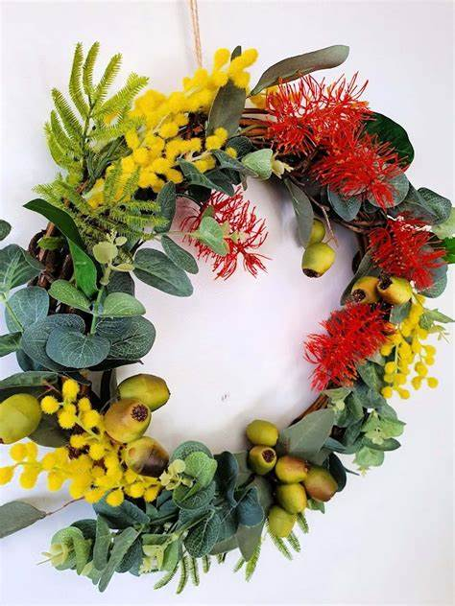
GBNC Newsletter
Community Development
Summer 2023
Update -
Healthy Ageing Support Program
The Healthy Ageing Support program is for over 65-year-olds, living at home in the Southern Downs, aimed at assisting them to connect to support services and enhance their social connections.
It's anticipated that through improved social connectedness the person’s (or couples) sense of isolation or loneliness is reduced and consequently experience improved physical health too.
Initial referrals will come from the Aged Care Nurse Navigators at the Warwick and Stanthorpe Hospital, before extending to the general community in due course.
Debbie will be out and about meeting services and commencing service delivery before the end of 2023.
Merry Xmas to one and all
from the GBNC team
How many individuals are helped through GBNC Foodsupport??
GBNC’s Foodsupport program recently realised that simply counting the 1 box of food failed to give the full picture. Because, that 1 box is NOT the same as another, either in number of people it feeds or the food value in that box.
We are failing to get a fuller picture of the number of people who are benefiting from that box of food and the social cost of this donated food.
Fiona our Foodsupport Program Coordinator reviewed the numbers in a family data which is given to the volunteers when packing boxes.
For the 22/23 financial year the number of people helped through a food box and the cost of those boxes are:
For a fully volunteer reliant program that is significant support to GB residents via GBNC and the broader community via donations to FS.
Update –
Online directory and community diary
This community available for use tool is a partnership between Rotary Club of Stanthorpe and GBNC.
GBNC’s Jaqui Unold is overseeing implementation of this project ably assisted by Shane Linton, GBNC’s IT consultant and Helen McWater, a very supportive volunteer.
Through to the end of December the focus is getting the pages set up as we want them, for all GBNC staff to note the diverse range of contacts they know and use in the Granite Belt communities.
From the new year it is GBNC’s intention to use the online diary as another key means to inform community members of what is happening when.
It’s anticipated the launch of the directory and diary will occur in the lead up to the Apple and Grape Festival.
Contact: Jennifer Leigh
Phone: (07) 38494193
Mobile: 0400505943
PO Box 5065
Mt Gravatt East, QLD 4122
Email infotdsa@gmail.com
Website:
www.tdsa.org.au
Page sponsored by:
ABN 77638540511
Page 2
A vibrant organisation growing, building and nurturing our community

Slide 3
GBNC Newsletter
Community Development
Summer 2023
Update –
Improving transport access within the Granite Belt
GBNC was funded by the Primary Health Network (PHN) for a 1year project to improve access within the Granite Belt via community transport – that is local transport.
GBNC has been working with a community reference group and reporting on this project’s progress to the Stanthorpe Hospital’s Community Consultative Committee.
It’s taken a while for this project to shape up. However, it’s expected that in the new 2024 year there will be announcement of a Stanthorpe-based worker with the role to establish STAR Community Services’ office focused on community transport for the Granite Belt.
While the PHN money is tied to local transport, the reference group is also interested in the longer trips to places like Warwick and Toowoomba.
It’s the community transport reference group’s goal to bring STAR to the Granite Belt and commence offering transport services its funded for by both the State and Federal governments. Their funding is available to persons 18yrs+ through to the aged (who are not resident in nursing homes). And, their transport is for both local and the longer-haul trips.
SO… keep an eye out on facebook for updates on what community transport in the Granite Belt will be available; early 2024.
Update –
Online directory and community diary
This community-available-for-use tool is a partnership between Rotary Club of Stanthorpe and GBNC.
GBNC’s Jaqui Unold is overseeing this project ably assisted by Shane Linton, GBNC’s IT consultant and Helen McWater, a very supportive volunteer.
Through to the end of December GBNC’s focus is getting the pages set up as we want them and for all GBNC staff to document and have added to the directory the huge number of contacts they know and use in the Granite Belt.
From the new year it is GBNC’s intention to use the online diary as another key means to inform community members of what is happening when. It’s anticipated the launch of the directory and diary will occur in the lead up to the Apple and Grape Festival.
If you would like to look at the directory as it currently is, use this URL:
https://www.mycommunitydirectory.com.au/Queensland/Southern_Downs
And if you scroll down the page and look to the left side you will see a box saying community diary. Click on that box and the screen changes to show what is on for any given date.
YOU CAN ENTER YOUR INFORMATION INTO THE DIRECTORY AND/OR DIARY – NOW!
Just click on List for Free found on top of website page to the right side.
Contact: Jennifer Leigh
Phone: (07) 38494193
Mobile: 0400505943
PO Box 5065
Mt Gravatt East, QLD 4122
Email infotdsa@gmail.com
Website:
www.tdsa.org.au
Page sponsored by:
ABN 77638540511
Page 3
A vibrant organisation growing, building and nurturing our community

Slide 4
GBNC Newsletter
Our services
Summer 2023
Early Years
Activities for parents and their children (prenatal to 8 years) aimed at assisting effective parenting skills.
Youth
Activities aimed at working with youth who are at risk of disengaging from school, family and/or the community 12 – 21yrs.
Mental Wellbeing (PHN)
Focused on initiatives to improve families and children's mental health transitioning to high school.
Family Support Services
Assists vulnerable families to
develop family/household management skills, improve life skills and provide information, advice and referral.
Healthy Ageing Support
Supports senior Southern Downs residents to live at home through enhanced social connections.
Sustaining Tenancies
Available through GBNC for clients who need a helping hand. A realistic payment plan is set up to come out of your Centrelink payments
Food Support
Available weekly on a Thursday morning via a referral from GBNC staff. Clients are to attend our Food Support 15 Hilton St 10—11am only.
Emergency Relief
Available to assist on a time-limited basis with basic life needs and is available to any person/resident in the area including backpackers
Community Support Services
Works in a diverse range of ways including community development aimed at increasing sense of connectedness and build community capacity.
Kids Korner
Limited hours childcare for children aged 15 months to 5 years. Days of operation are Mondays, Wednesdays and Fridays.
Casual use is encouraged.
Driving Work/Life Opportunities
Aims to expand life options & employment through addressing the barriers that prevent persons aged16-25 years from obtaining a drivers licence. This program works with the PCYC’s Braking the Cycle Stanthorpe program.
If you would like to be notified of GBNC’s upcoming events follow us on Facebook or Instagram
Page 4
A vibrant organisation growing, building and nurturing our community

